Slide 1

Introduction to NGS
Data Analysis

Slide 2
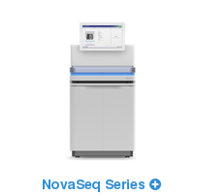
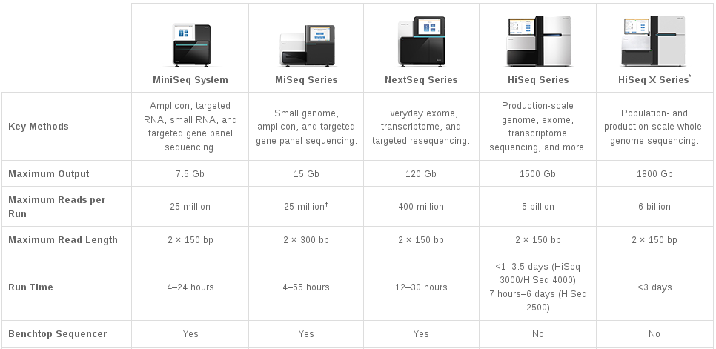
Illumina Sequencing Technology
NovaSeq 5000
Same as HiSeq
2000 Gb
6.6 billion
2 x 150 bp
19 - 40 hrs
no
http://www.illumina.com/systems/sequencing-platforms.html (Oct 2017)

Slide 3
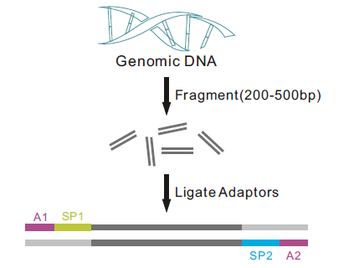
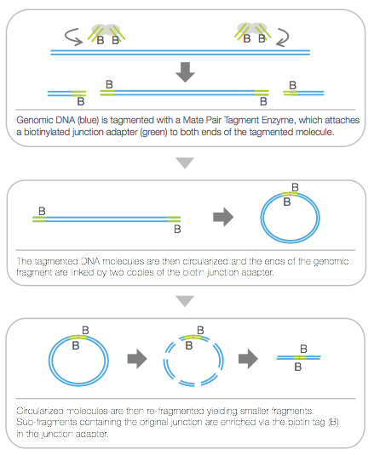
Illumina Sequencing Libraries
illumina.com
single end paired ends mate pairs
fragment size
~2,000 bp
~400 bp
~400 bp
sequenced region
(read length)
sequenced regions
(read length)
~400 bp “fragment size”
~2,000 bp “insert size”

Slide 4
Paired End Reads
Read 1 of a pair
100 base read length
dsDNA
Read 2 of a pair
~200 bp
100 base read length
~400 bp fragment size
Read 1 pair fastq file
FASTQ format
@M00861:1:000000000-A36BE:1:1101:14650:1529 1:N:0:8
TTCTTAAAAATACCATAAAAGGCTTAAACTTGCCATTTACGACGGATTAATTCCAACTCTTTTCGGCTATCTTCATCTTTTAAGGTTAAATGACTCATAACGG
+
FFFHBFFHHIIIIIIHFHHCGEFGHHIHHHIHD/?DGGHHH@DEB,5EGHGHHIIHIF?FGGHHCCBFDGHFHDGHGFFFGDFHH?DFHDFFHHFHFHFFHHH
Read 2 pair fastq file
@M00861:1:000000000-A36BE:1:1101:14650:1529 2:N:0:8
ACTAAAAATCAATTTTATCAATTTCAAGCTCTACCTTATTTACTCATTATTTTAGTGATGGCCACTTTAATAAAAATATTGGTAGCATATTTTGCAATAGCGG
+
BFFHIHHHFHHDGHIHHIHHHGHHHHHFHHDFFHIHIIIHIHDFHHHIHIIIH=AAFHIIIHFGFHHHHHGGHHIHHFGFFFEGGHHHDGHHH/CGHIFFHHH

Slide 5
Maintain Read Pair Order
L1
R1
L2
R2
L3
R3
L4
R4
L5
R5
L1
L6
R1
L2
R6
R2
L3
R3
L4
DNA Fragment lengths will be different but
sequence reads may all be the same length
R4
L5
R5
L6
R6
Left Read 1 paired end fastq file
Right Read 2 paired end fastq file

Slide 6
MiSeq Can Perform Initial QC Trimming
L1
R1
L2
R2
L3
R3
L4
R4
L5
R5
L1
L6
R1
L2
R6
R2
L3
R3
L4
DNA Fragment lengths will be different but
sequence reads can have different lengths
R4
L5
R5
L6
R6
Left Read 1 paired end fastq file
Right Read 2 paired end fastq file

Slide 7
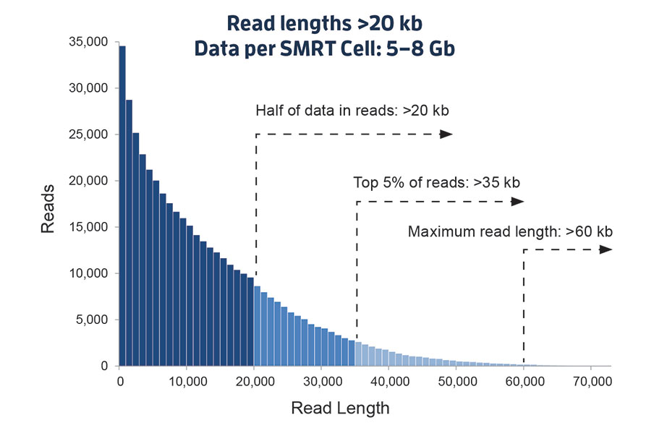

PacBio Long Read Sequencing
Sequel Sequencer
pacb.com

Slide 8
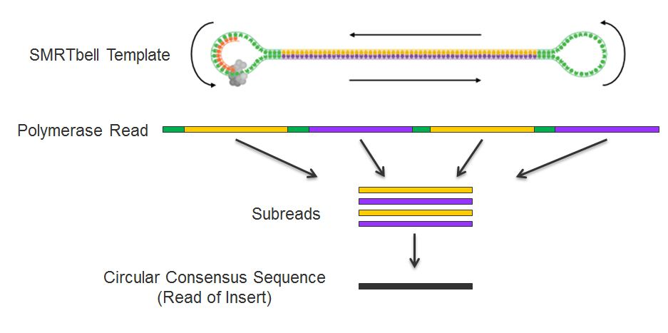
PacBio Long Read Sequencing
Strand yellow
Strand purple
Shorter DNA fragment equals more subreads
pacb.com

Slide 9
PacBio Sequencing Tools on Ada
PBSuite
PBJelly aligns PacBio reads to draft assemblies
Proovread and LSC
Correct PacBio reads with Illumina reads
Computationally intensive
Canu
PacBio long read assembler
https://hprc.tamu.edu/wiki/Ada:NGS:PacBio_tools

Slide 10
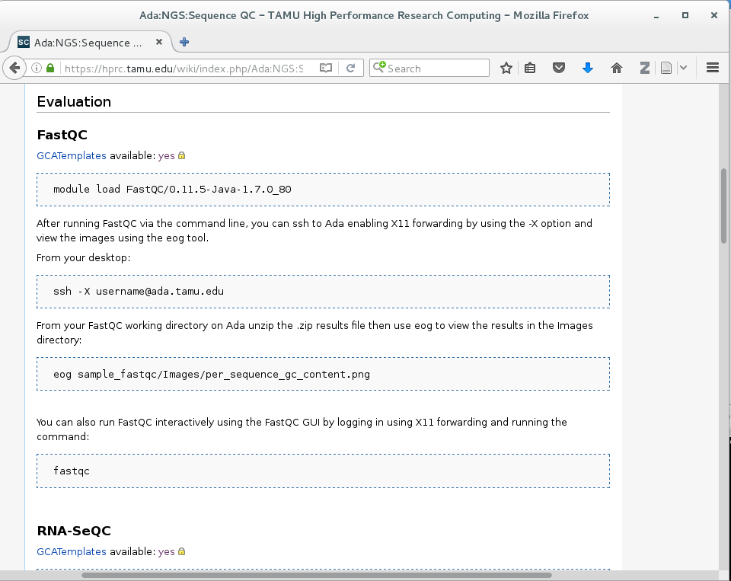
Access GCATemplate Scripts for Ada from the HPRC wiki
https://hprc.tamu.edu/wiki/index.php/Ada:NGS:Sequence_QC#FastQC
Click to see template script on github

Slide 11
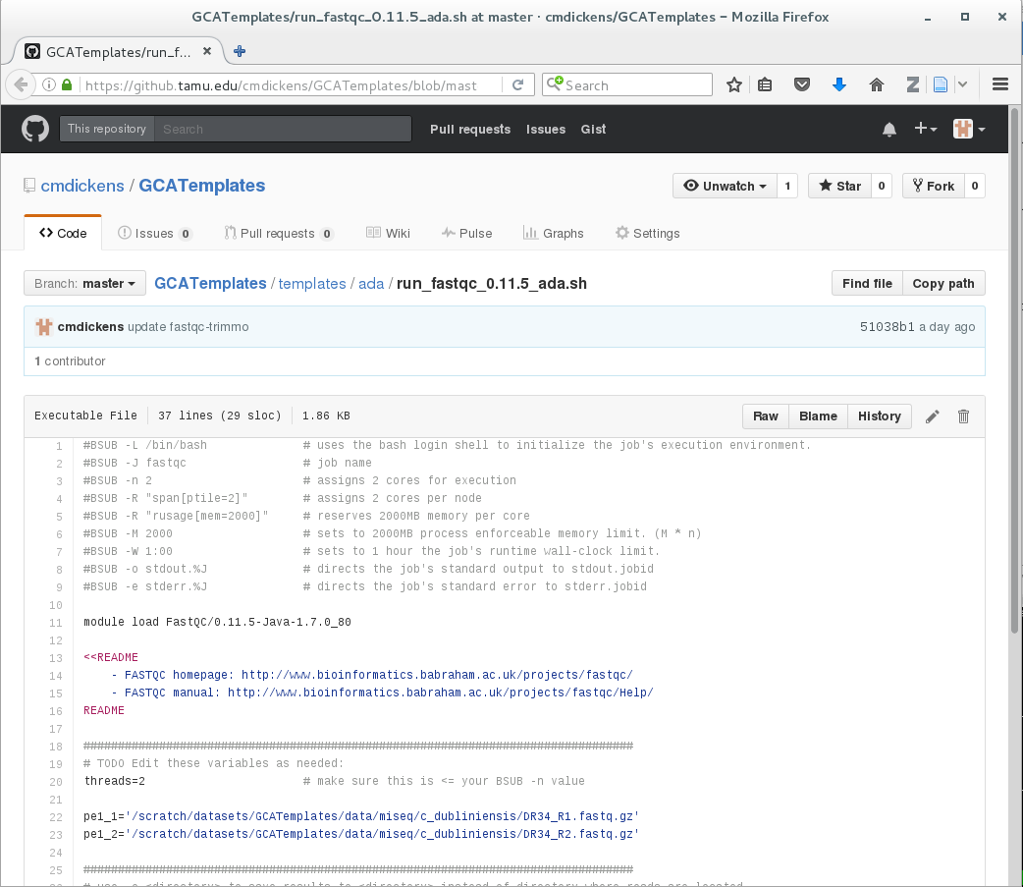

Slide 12
Sample GCATemplate Job Script (Ada)
#BSUB -L /bin/bash
#BSUB -J blastx
#BSUB -n 1
#BSUB -R "span[ptile=1]"
#BSUB -R "rusage[mem=2500]"
#BSUB -M 2500
#BSUB -W 2:00
#BSUB -o stdout.%J
#BSUB -e stderr.%J
module load BLAST+/2.2.31-intel-2015B-Python-3.4.3
<<README
BLAST manual: http://www.ncbi.nlm.nih.gov/books/NBK279690/
README
# blastx: search protein databases using a translated nucleotide query
blastx -query mrna_seqs_nt.fasta -db /scratch/datasets/blast/nr \
-outfmt 10 -out mrna_seqs_nt_blastout.csv

Slide 13
Sample GCATemplate Job Script (Ada)
#BSUB -L /bin/bash
#BSUB -J blastx
#BSUB -n 1
#BSUB -R "span[ptile=1]"
#BSUB -R "rusage[mem=2500]"
#BSUB -M 2500
#BSUB -W 2:00
#BSUB -o stdout.%J
#BSUB -e stderr.%J
module load BLAST+/2.2.31-intel-2015B-Python-3.4.3
<<README
BLAST manual: http://www.ncbi.nlm.nih.gov/books/NBK279690/
README
# blastx: search protein databases using a translated nucleotide query
blastx -query mrna_seqs_nt.fasta -db /scratch/datasets/blast/nr \
-outfmt 10 -out mrna_seqs_nt_blastout.csv
These parameters are read by the job scheduler
Load the required module(s) first
This is a section of comments
This is a single line comment and not run as part of the script
This is the command to run the application
This means the command is
continued on the next line;
The space before the \ is required
Do not put a space after the \

Slide 14
Use $TMPDIR whenever possible
Use the $TMPDIR if the application you are running can utilize a temporary directory for writing temporary files which are deleted when the job ends
A temp directory ($TMPDIR) is automatically assigned for each job which uses the disk(s) on the compute node not the $SCRATCH shared file system
Especially useful when a computational tool writes tens of thousands of temporary files which are deleted when the job is finished and are not needed for the final results
This is useful since files on $TMPDIR will not count against your file quota
Don't use $TMPDIR if your software uses temporary files for restarting where it left off if it should stop before completion
Will significantly speed up an mpiBLAST job
java -Xmx53g -jar $EBROOTPICARD/FastqToSam.jar TMP_DIR=$TMPDIR \
FASTQ=$pe1_1 FASTQ2=$pe1_2 OUTPUT=$outfile SAMPLE_NAME=$sample_name \
SORT_ORDER=$sort_order MAX_RECORDS_IN_RAM='null'

Slide 15
Quality Control (QC)

Slide 16
QC Evaluation
Use FastQC to visualize quality scores
Displays quality score distribution of a subset of ~200,000 reads
Input is a fastq file or files
Can disable grouping (binning) of sequence regions
Will alert you of poor read characteristics
Can be run as a GUI or a command line interface
module load FastQC/0.11.5-Java-1.7.0_80
FastQC will process using one CPU core per file
If there are 10 fastq files to analyze and 4 cores used
4 files will start processing and 6 will wait in a queue
If there is only one fastq file to process then using 10 cores does not speed up the process

Slide 17
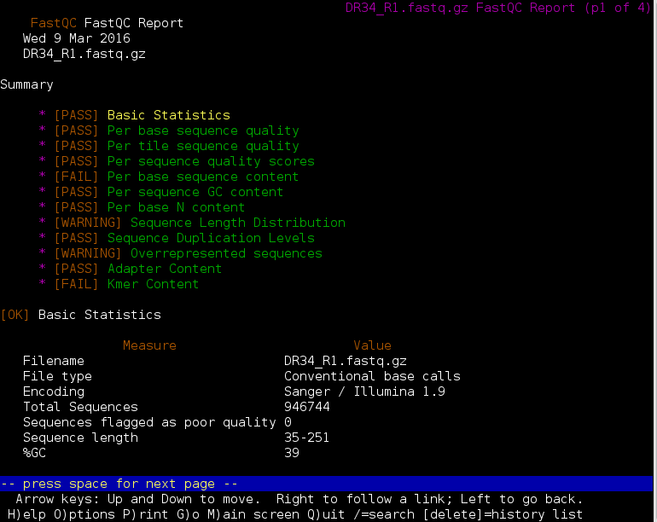
FastQC Report using lynx
lynx DR34_R1_fastqc.html

Slide 18
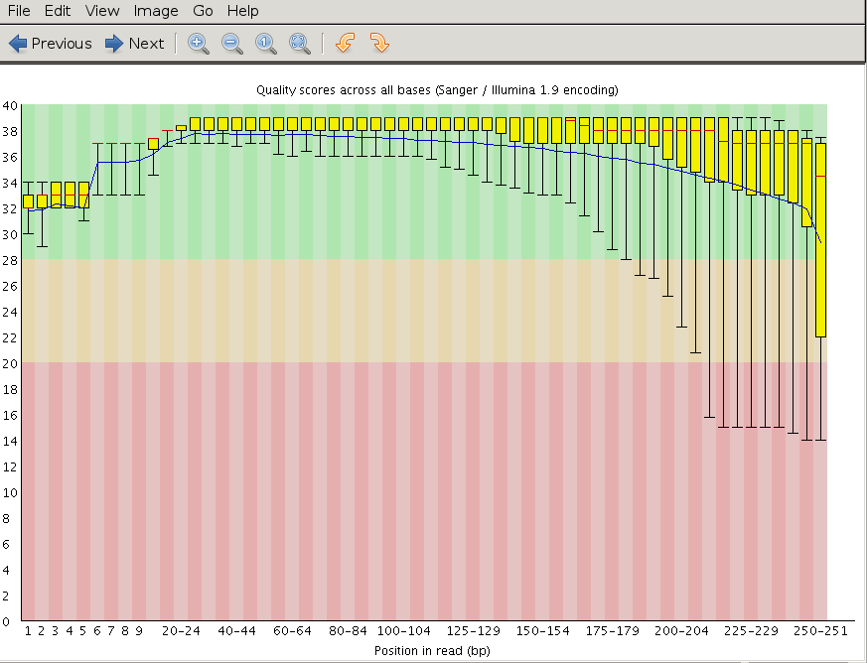
FastQC Output Image Quality Distribution
@ERR504787.2.1 M00368:15:000000000-A0HKH:1:5:21261:10968-1 length=100
GATCGGAAGAGCACACGTCTGAACTCCAGTCACGATCAGATCTCGTATGCCGTCTTCTGCTTGAAAAAAAAAAAAAAAACAAAAAACATAATGCCGTAAA
+ERR504787.2.1 M00368:15:000000000-A0HKH:1:5:21261:10968-1 length=100
=:=4AD=B8A:+<A::1<:AE<C3*?F<B???<?:8:6?B*9BD;/638.=-'-.@7=).=A:6?DDDCBBBB9555&&)+((+2&&+((((((()&&&+
@ERR504787.3.1 M00368:15:000000000-A0HKH:1:3:12724:25677-1 length=100
GATGTTTTGTTACTGATTGGAACCATGATTGGTGCTTTACTTGGTTTCTTCCTATTTAACCACAAGCCTGCCAAAGTATTTATGGGAGATGTAGGTAGTT
+ERR504787.3.1 M00368:15:000000000-A0HKH:1:3:12724:25677-1 length=100
BCCFDEFFHHHHHJJJJIJJJJJJJJJJIJJJFHIJJJIJJJJJIJJJJJJJIJJJIJIIJJJJJFHJJJJIJJHH=CHHFFFFFFEDDEDEEEDCCDCE
@ERR504787.5.1 M00368:15:000000000-A0HKH:1:2:16161:12630-1 length=100
TATTTTAAGTGACCAAGGAATGACTCCCCAATCATGGCTGTATCAACTCCAAAATTTTCTGCAACAGTCGCTGAAATATCTGCAAAATGCCCTTGTGGAA
+ERR504787.5.1 M00368:15:000000000-A0HKH:1:2:16161:12630-1 length=100
CCCFFFFFHHHHHJJJJJJJJJJJJJJJJJJJJJJJJJJJJJJJJJJJJJJJJJJJJJJJJJJIJJJHIJHHGFFFFFFFEEEEEEDDDDDDDDDCDDDD
FASTQ format

Slide 19
FastQC Output Image Quality Distribution
@ERR504787.2.1 M00368:15:000000000-A0HKH:1:5:21261:10968-1 length=100
GATCGGAAGAGCACACGTCTGAACTCCAGTCACGATCAGATCTCGTATGCCGTCTTCTGCTTGAAAAAAAAAAAAAAAACAAAAAACATAATGCCGTAAA
+ERR504787.2.1 M00368:15:000000000-A0HKH:1:5:21261:10968-1 length=100
=:=4AD=B8A:+<A::1<:AE<C3*?F<B???<?:8:6?B*9BD;/638.=-'-.@7=).=A:6?DDDCBBBB9555&&)+((+2&&+((((((()&&&+
@ERR504787.3.1 M00368:15:000000000-A0HKH:1:3:12724:25677-1 length=100
GATGTTTTGTTACTGATTGGAACCATGATTGGTGCTTTACTTGGTTTCTTCCTATTTAACCACAAGCCTGCCAAAGTATTTATGGGAGATGTAGGTAGTT
+ERR504787.3.1 M00368:15:000000000-A0HKH:1:3:12724:25677-1 length=100
BCCFDEFFHHHHHJJJJIJJJJJJJJJJIJJJFHIJJJIJJJJJIJJJJJJJIJJJIJIIJJJJJFHJJJJIJJHH=CHHFFFFFFEDDEDEEEDCCDCE
@ERR504787.5.1 M00368:15:000000000-A0HKH:1:2:16161:12630-1 length=100
TATTTTAAGTGACCAAGGAATGACTCCCCAATCATGGCTGTATCAACTCCAAAATTTTCTGCAACAGTCGCTGAAATATCTGCAAAATGCCCTTGTGGAA
+ERR504787.5.1 M00368:15:000000000-A0HKH:1:2:16161:12630-1 length=100
CCCFFFFFHHHHHJJJJJJJJJJJJJJJJJJJJJJJJJJJJJJJJJJJJJJJJJJJJJJJJJJIJJJHIJHHGFFFFFFFEEEEEEDDDDDDDDDCDDDD
Average quality score distribution at position one
Upper extreme
Upper quartile
median
lower quartile
lower extreme

Slide 20
FastQC Output Image Quality Distribution
@ERR504787.2.1 M00368:15:000000000-A0HKH:1:5:21261:10968-1 length=100
GATCGGAAGAGCACACGTCTGAACTCCAGTCACGATCAGATCTCGTATGCCGTCTTCTGCTTGAAAAAAAAAAAAAAAACAAAAAACATAATGCCGTAAA
+ERR504787.2.1 M00368:15:000000000-A0HKH:1:5:21261:10968-1 length=100
=:=4AD=B8A:+<A::1<:AE<C3*?F<B???<?:8:6?B*9BD;/638.=-'-.@7=).=A:6?DDDCBBBB9555&&)+((+2&&+((((((()&&&+
@ERR504787.3.1 M00368:15:000000000-A0HKH:1:3:12724:25677-1 length=100
GATGTTTTGTTACTGATTGGAACCATGATTGGTGCTTTACTTGGTTTCTTCCTATTTAACCACAAGCCTGCCAAAGTATTTATGGGAGATGTAGGTAGTT
+ERR504787.3.1 M00368:15:000000000-A0HKH:1:3:12724:25677-1 length=100
BCCFDEFFHHHHHJJJJIJJJJJJJJJJIJJJFHIJJJIJJJJJIJJJJJJJIJJJIJIIJJJJJFHJJJJIJJHH=CHHFFFFFFEDDEDEEEDCCDCE
@ERR504787.5.1 M00368:15:000000000-A0HKH:1:2:16161:12630-1 length=100
TATTTTAAGTGACCAAGGAATGACTCCCCAATCATGGCTGTATCAACTCCAAAATTTTCTGCAACAGTCGCTGAAATATCTGCAAAATGCCCTTGTGGAA
+ERR504787.5.1 M00368:15:000000000-A0HKH:1:2:16161:12630-1 length=100
CCCFFFFFHHHHHJJJJJJJJJJJJJJJJJJJJJJJJJJJJJJJJJJJJJJJJJJJJJJJJJJIJJJHIJHHGFFFFFFFEEEEEEDDDDDDDDDCDDDD
Positions are ‘binned’ after the first few positions

Slide 21
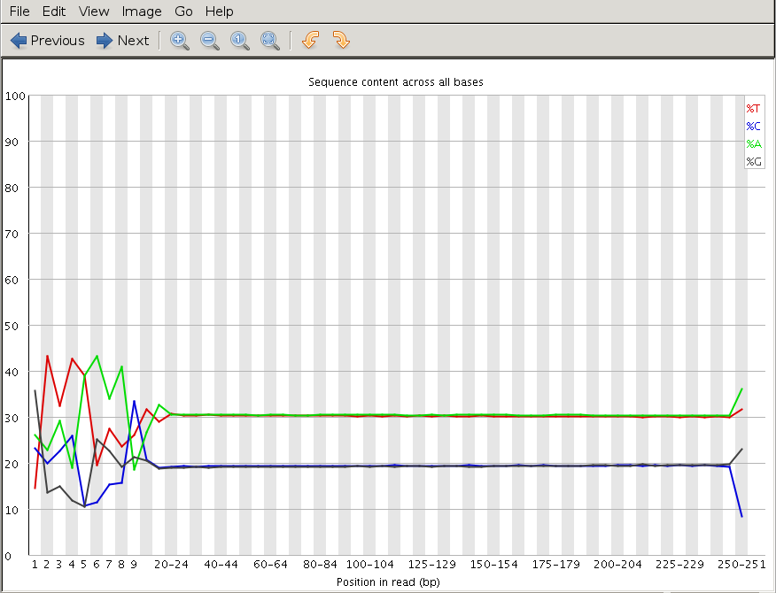
Illumina Transposon Insertion Site
per_base_sequence_content.png

Slide 22
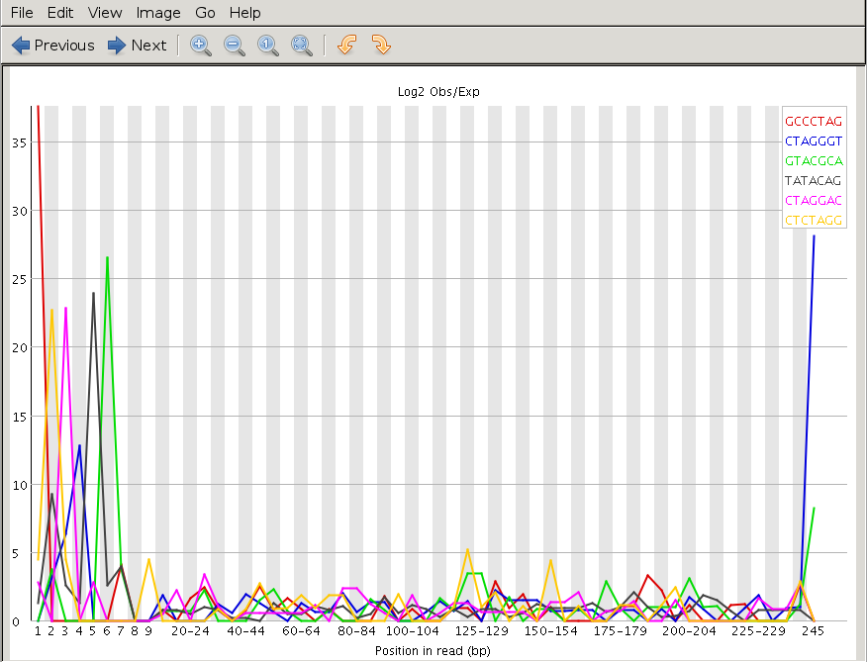
Illumina Transposon Insertion Site
kmer_profiles.png

Slide 23
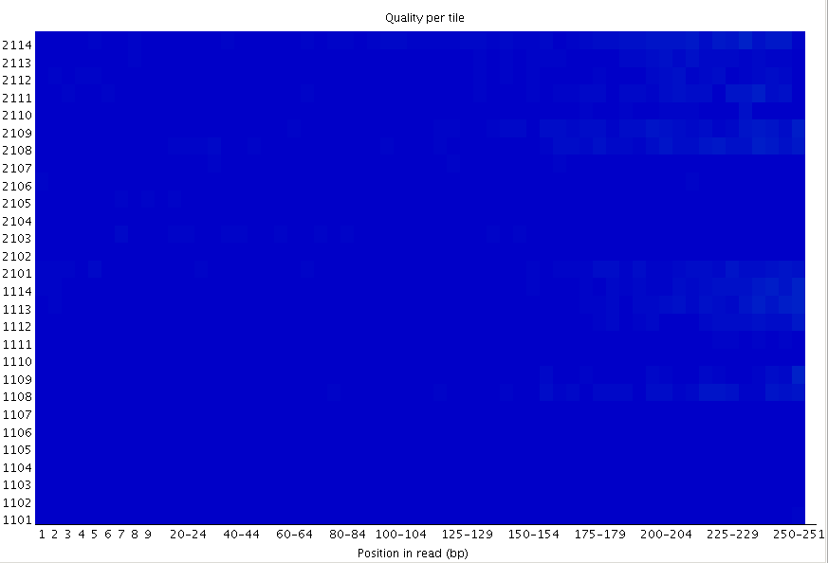
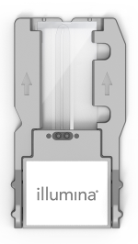

FastQC Flowcell Quality Image
per_tile_quality.png
Flowcell quality mapping
Good per_tile quality
MiSeq flowcell
good quality poor quality

Slide 24
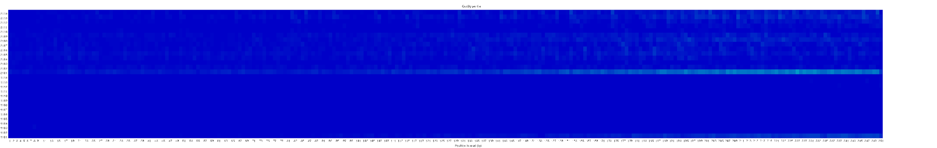
FastQC Flowcell Quality Image
per_tile_quality.png
bottom of
flowcell
MiSeq flowcell
top of
flowcell
good quality poor quality

Slide 25
Failed QC Examples

Slide 26
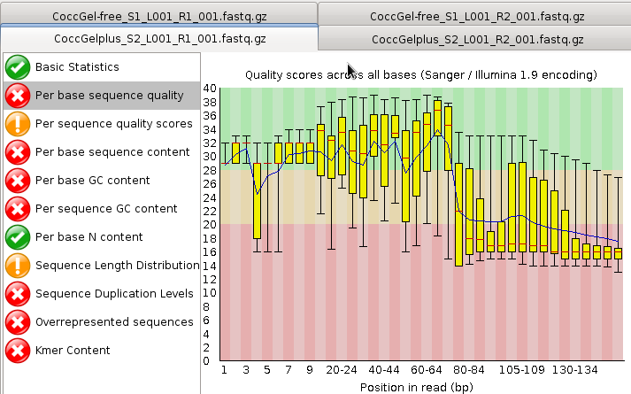
FastQC Output Image Failed Per base sequence quality
Example 1. Expired MiSeq mate-pair kit (9 months expired)

Slide 27
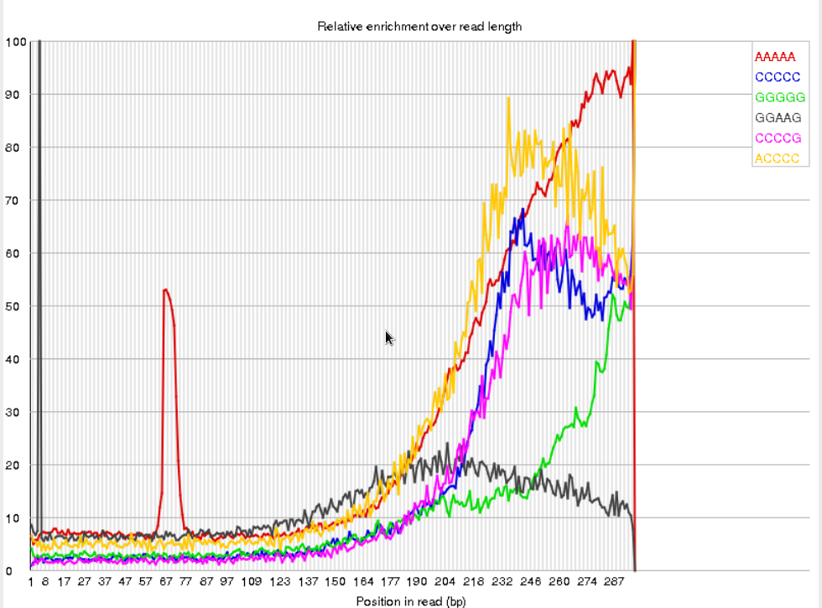
FastQC Output Image Failed Kmer Content
Example 2. Sequence prep adapters still on ends of DNA library fragments

Slide 28
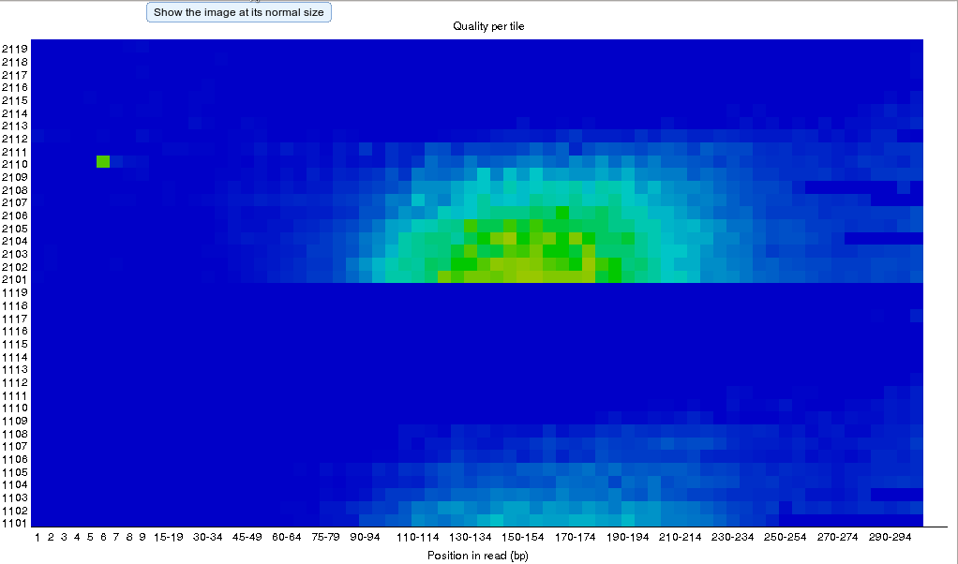
FastQC Output Image Flowcell: not good per_tile quality
Example 3. Faulty flowcell
MiSeq flowcell
good quality poor quality

Slide 29
QC Quality Trimming
Sequence quality trimming tools
Trimmomatic will maintain paired end read pairing after trimming
Trim reads based on quality scores
Trim the same number of bases from each read or
Use a sliding window to calculate average quality at ends of sequences
Decide if you want to discard reads with Ns
some assemblers replace Ns with As or a random base G, C, A or T
Trim adapter sequences
Trimmomatic has a file of Illumina adapter sequences
module spider Trimmomatic
recommended tool
module load Trimmomatic/0.36-Java-1.8.0_92
ls $EBROOTTRIMMOMATIC/adapters/

Slide 30
Paired End Short Reads
Read 1 of a pair
100 base read length
dsDNA
Read 2 of a pair
~200 bp
100 base read length
~400 bp fragment size
Read 1 pair fastq file
FASTQ format
@M00861:1:000000000-A36BE:1:1101:14650:1529 1:N:0:8
TTCTTAAAAATACCATAAAAGGCTTAAACTTGCCATTTACGACGGATTAATTCCAACTCTTTTCGGCTATCTTCATCTTTTAAGGTTAAATGACTCATAACGG
+
FFFHBFFHHIIIIIIHFHHCGEFGHHIHHHIHD/?DGGHHH@DEB,5EGHGHHIIHIF?FGGHHCCBFDGHFHDGHGFFFGDFHH?DFHDFFHHFHFHFFHHH
Read 2 pair fastq file
@M00861:1:000000000-A36BE:1:1101:14650:1529 2:N:0:8
ACTAAAAATCAATTTTATCAATTTCAAGCTCTACCTTATTTACTCATTATTTTAGTGATGGCCACTTTAATAAAAATATTGGTAGCATATTTTGCAATAGCGG
+
BFFHIHHHFHHDGHIHHIHHHGHHHHHFHHDFFHIHIIIHIHDFHHHIHIIIH=AAFHIIIHFGFHHHHHGGHHIHHFGFFFEGGHHHDGHHH/CGHIFFHHH

Slide 31
dsDNA
Trimming PE Short Sequence Reads
File 1 from sequencer File 2 from sequencer
100 bases 100 bases
100 bases 50 bases
minimun read length = 40
Resulting FASTQ Files with trimmed reads
Paired end 1 trimmed file Paired end 2 trimmed file
QC trim
QC trim

Slide 32
dsDNA
Trimming PE Short Sequence Reads
File 1 from sequencer File 2 from sequencer
100 bases 100 bases
100 bases 20 bases
minimun read length = 40
Resulting FASTQ Files with trimmed reads
Paired end 1 trimmed file Paired end 2 trimmed file Single end reads
QC trim
QC trim

Slide 33
Merge Overlapping Paired End Short Reads
fragment 1
dsDNA
fragment 2
dsDNA

Slide 34
Merge Overlapping Paired End Short Reads
fragment 1
dsDNA
fragment 2
dsDNA
Paired end read 1 (left) Paired end read 2 (right)

Slide 35
Merge Overlapping Paired End Short Reads
fragment 1
dsDNA
fragment 2
dsDNA
Paired end read 1 (left) Paired end read 2 (right) Unpaired ‘merged’ read
module spider FLASH
Tools for merging overlapping reads:
module spider Coperead
module spider PEAR

Slide 36
Verifying and Trimming Mate Pair Reads
Biotin junction
adapter sequence 38 bp
illumina.com
true mate pair
true mate pair
true mate pair
?
?
(paired end contaminant)
Tool for trimming Illumina Nextera mate pairs:
module spider NextClip

Slide 37
Verifying and Trimming Mate Pair Reads
Biotin junction
adapter sequence 38 bp
illumina.com
true mate pair
true mate pair
true mate pair
?
?
(paired end contaminant)
Tool for trimming Illumina Nextera mate pairs:
module spider NextClip

Slide 38
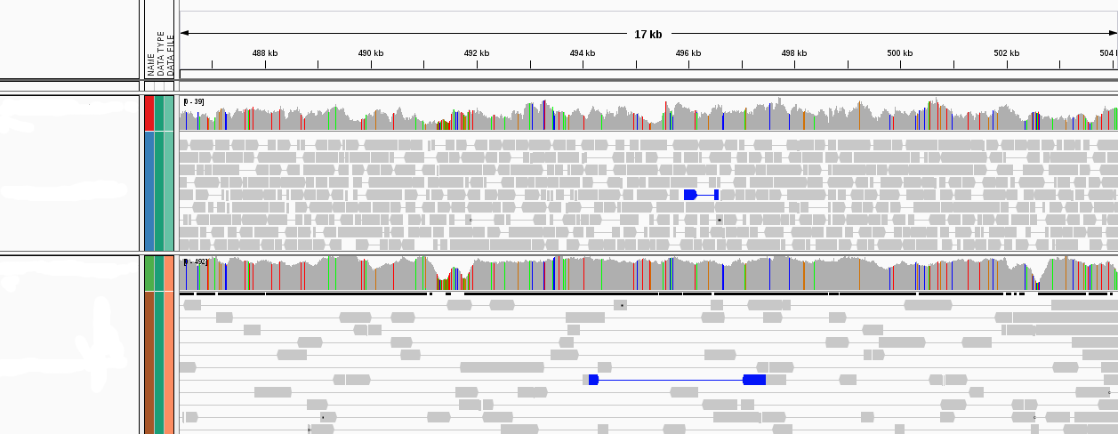
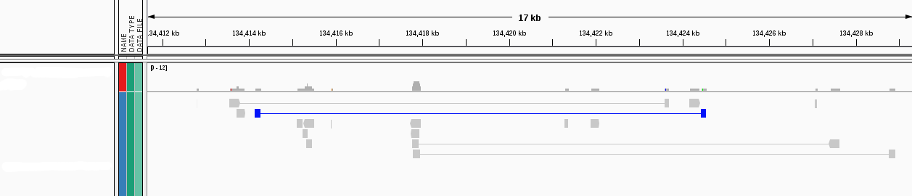
Illumina Sequencing Libraries Insert Sizes
paired-end
417 bp
mate-pair
2,277 bp
mate-pair
10,248 bp

Slide 39
Sequence Mapping and Visualization

Slide 40
Mapping Reads to a Reference Assembly
Align reads using bwa
bwa index files for UCSC genomes found here
Align reads using bowtie or bowtie2
Bowtie index files for UCSC genomes found here:
Bowtie2 index files for UCSC found here:
module spider BWA
/scratch/datasets/genome_indexes/ucsc/mm10/bwa_0.7.12_index/
module spider Bowtie
/scratch/datasets/genome_indexes/ucsc/mm10/bowtie_index/
module spider Bowtie2
/scratch/datasets/genome_indexes/ucsc/mm10/bowtie2_index/

Slide 41
Sequence Alignment/Map (SAM) Format
@HD VN:1.3 SO:coordinate
@SQ SN:1 LN:3214061
@SQ SN:2 LN:2289089
@SQ SN:3 LN:1863824
@SQ SN:4 LN:1641709
@SQ SN:5 LN:1245899
@SQ SN:6 LN:1073895
@SQ SN:7 LN:1022435
@SQ SN:R LN:2267510
@RG ID:uom LB:pe SM:dr34 PL:ILLUMINA
@PG ID:bwa PN:bwa VN:0.7.12-r1039 CL:bwa sampe -r @RG\tID:uom\tLB:pe\tSM:dr34\tPL:ILLUMINA C_dubliniensis.fasta pe_1.aln.sai pe_2.aln.sai DR34_R1.fastq.gz DR34_R2.fastq.gz
M00861:62:000000000-AF1EM:1:2106:14651:23759 97 1 14 0 111M = 14 111 GACAAATAGAGTTGTTTATTTTAATTCAGAGAAGAATCAGTTGTTCATTGTTAAGATCACAGACAGAATTCTGTTGTTTGTTTAGTCGCAAAAGAATCAGCTACAATACAG BBCCCBFFFFFFGGGGGGGGGGHHHHHHHHHHHHHHHHHHHHHHHHHHHHHHHHHHHIHHHIHHHHHHHHHHHHHHGHHHHHHHHHHGGGGGHHGHHHHHHHHHHHHHHHH RG:Z:uom XT:A:R NM:i:0 SM:i:0 AM:i:0 X0:i:2 X1:i:0 XM:i:0 XO:i:0 XG:i:0 MD:Z:111 XA:Z:R,-2263390,111M,0;
Header
Sequences and mapping
details

Slide 42
Sorting Alignment sam/bam Files
Sequence Alignment/Map format (sam)
view sam files using the UNIX command:
Binary Alignment/Map format (bam)
Compressed (binary) sam files need samtools to view
Can use samtools or picard tools to create sorted bam file
sort sam/bam file based on coordinate into bam format for viewing
Create an index of the bam file using samtools
A samtools index is needed prior to viewing bam files in browsers
more dr34.sam
module load SAMtools/1.7-GCCcore-6.3.0
samtools sort -@ 2 -m 2G -o dr34.bam dr34.sam
samtools index dr34.bam
dr34.bam.bai

Slide 43
Viewing sam/bam Files
Viewing bam files using samtools
samtools view dr34.bam | more
view only alignments
samtools view -H dr34.bam
view only header
samtools view -h dr34.bam | more
view header + alignments

Slide 44
Alignment Statistics
samtools flagstat dr34.bam
150000 + 0 in total (QC-passed reads + QC-failed reads)
0 + 0 secondary
0 + 0 supplementary
0 + 0 duplicates
140150 + 0 mapped (93.43% : N/A)
150000 + 0 paired in sequencing
75002 + 0 read1
74998 + 0 read2
85639 + 0 properly paired (57.09% : N/A)
136854 + 0 with itself and mate mapped
3296 + 0 singletons (2.20% : N/A)
909 + 0 with mate mapped to a different chr
56 + 0 with mate mapped to a different chr (mapQ>=5)
Both reads in the pair are mapped
on the same chromosome
and in FR or RF orientation

Slide 45
Sam Flags and Bits
Flags describe alignments (the flag value is the sum of bits)
read id
flag
chromosome
genome coordinate
sam format
B06PYABXX110322:2:2202:15484:157177 99 1 10016 0 86M15S = 10063 110
CCCTAACCCTAACCCTAACCACCCTAACCCTAACCCTAACCCTAACCCTAACCCTAACCCTAACCCTA
CDEGEHGHHIFIHIIJFIIIIJGJIIIIGJIIIJGJIJIJGHIJGKFHIJGKGIIHBIGIGHHHE@DF
57 XC:i:86 MD:Z:86 RG:Z:B06PY.2 AM:i:0 NM:i:0 SM:i:0 BQ:Z:BB MQ:i:0 XT:A:R
Filter bam alignments based on bit in flag (-f and/or -F)
Keep only reads that are 'mapped in proper pair'
Keep all except reads that are 'PCR or optical duplicate'
bits:
1 2 4 8 16 32 64 128 256 512 1024 2048
1 + 2 + 32 + 64 = 99
samtools view -h -b -f 2 dr34.bam > dr34_paired_reads.bam
samtools view -h -b -F 1024 dr34.bam > dr34_dedup_reads.bam

Slide 46
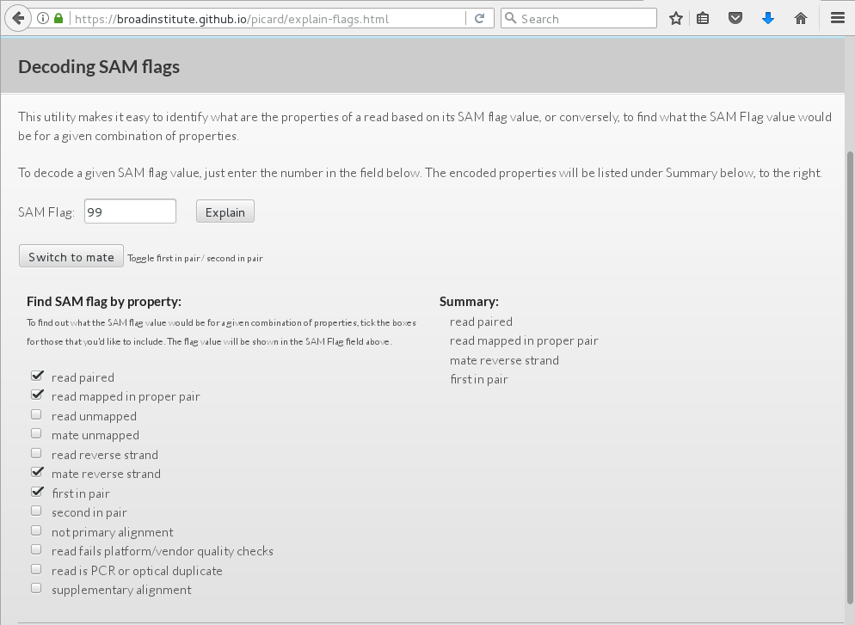
Sam Flags and Bits
https://broadinstitute.github.io/picard/explain-flags.html
Bits
1
2
4
8
16
32
64
128
256
512
1024
2048
SAM Flag is the sum of Bits
99 = 64 + 32 + 2 + 1

Slide 47
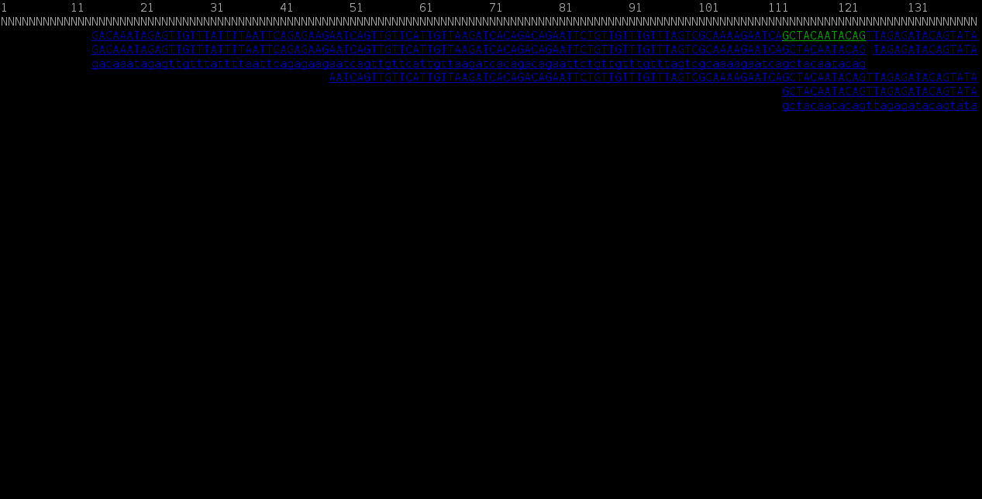
SAMtools without a Reference Genome
Reference genome represented on top as NNNNNNNNN
samtools tview dr34.bam

Slide 48
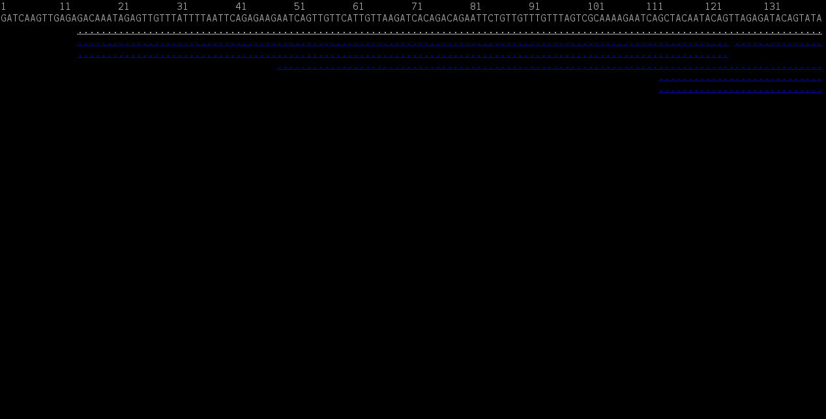
SAMtools with a Reference Genome
Reference genome sequence displayed on top
samtools tview dr34.bam c_dubliniensis.fa

Slide 49
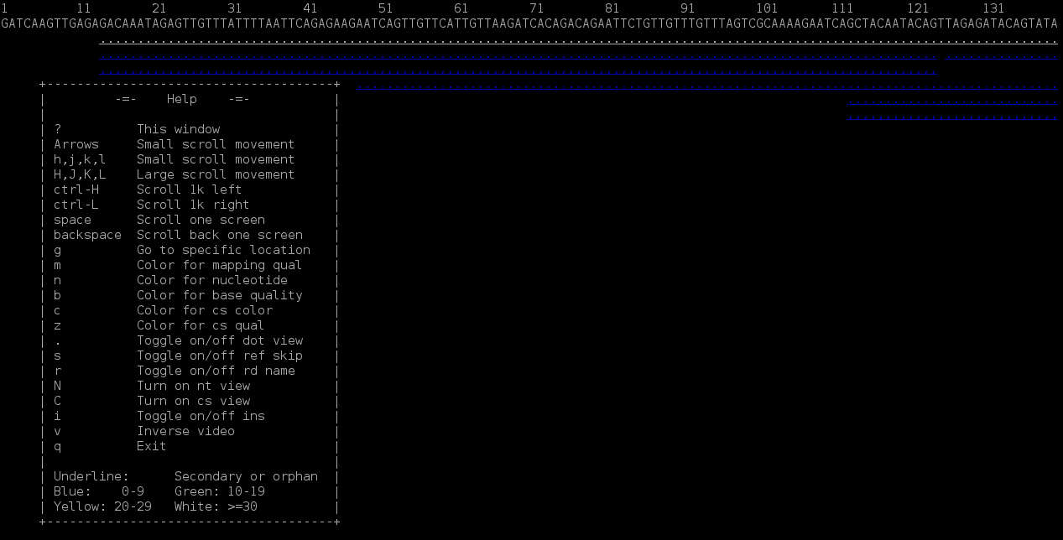
SAMtools with a Reference Genome
^{Type ? for help menu}
samtools tview dr34.bam c_dubliniensis.fa

Slide 50
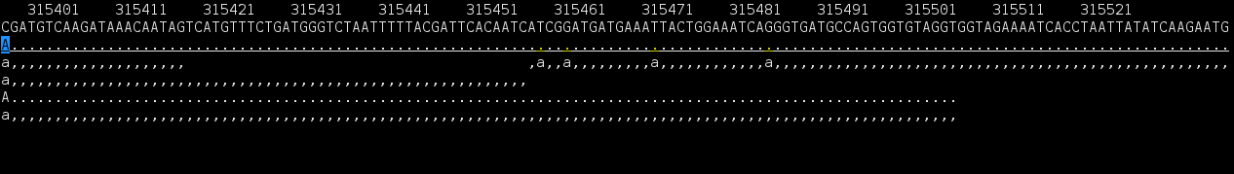
View at a Specific Coordinate
samtools tview dr34.bam c_dubliniensis.fa -p 1:315398

Slide 51
Sequence Error Correction
In Short Reads

Slide 52
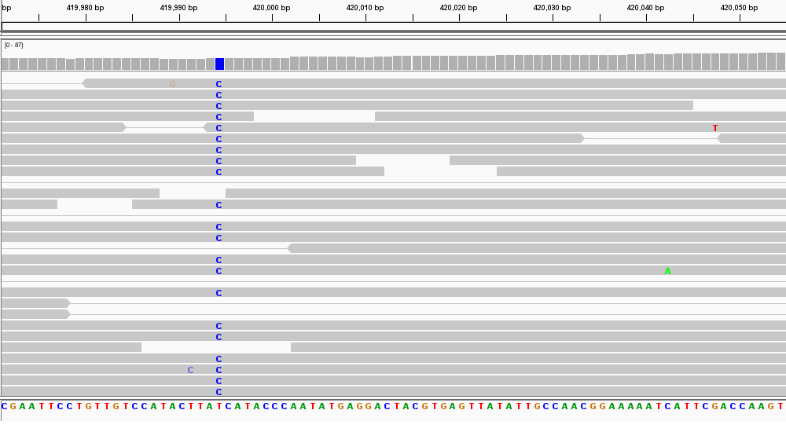
Sequencing Errors in Short Reads
SNP
Sequencing errors
reference genome
.
.
Tool for correcting sequencing errors:
module spider Lighter

Slide 53
Digital Normalization

Slide 54

Digital Normalization
Reduce memory requirements by reducing the number of redundant sequence reads if you have a very high sequencing coverage (> 200x)
module spider BBMap
Use the bbnorm.sh script in the BBMap module

Slide 55
Sequence Variant Calling

Slide 56
Sequence Variant Calling
Start with aligning reads to a reference
GATK does not require QC trimming
Mark PCR duplicates with Picard
Differentiate between sequencing errors and SNPs
Calling SNPs may require a min read depth of 10x (higher for indels)
Calling variants may require 1/3 of reads to contain SNP
Strand bias may result as a consequence of the sequencing chemistry's response to certain DNA sequence motifs but it can be detected computationally
BLAST reads with SNPs to identify variant calls due to misalignments especially with duplicated genes
Variant Call Format (vcf) – standard format of variant calls
Identify multiple-nucleotide polymorphism (MNP)
Two SNPs within a single codon
codon translation
Reference: TTT Phe
SNP 1: TTA Leu
SNP 2: TAT Tyr
SNP 1 + 2: TAA STOP

Slide 57
Marking PCR Duplicates
PCR duplicates are artifacts resulting from a PCR amplification step during NGS library preparations.
PCR duplicates should be removed/marked as to not bias the frequency of variants or gene expression levels
Use picard tools to mark duplicates
duplicates are marked not removed
Freebayes will ignore marked duplicates during variant calling
module spider picard

Slide 58
Variant Calling Tools
Use bam file of sequence reads aligned to a reference
as input for the following four work flows
GATK
No need to QC trim reads, the GATK best practices pipeline will perform the necessary steps including marking PCR duplicates
You need a set of known variants for your species (dbSNP) or you can bootstrap your population to get variant frequency
Used in conjunction with other tools
samtools
picard
2. SAMtools and BCFtools
3. VarScan
4. FreeBayes
module spider GATK picard SAMtools
module spider SAMtools BCFtools
module spider VarScan
module spider FreeBayes

Slide 59
Sample vcf File Format
##fileformat=VCFv4.0
##fileDate=20110705
##reference=1000GenomesPilot-NCBI37
##phasing=partial
##INFO=<ID=NS,Number=1,Type=Integer,Description="Number of Samples With Data">
##INFO=<ID=DP,Number=1,Type=Integer,Description="Total Depth">
##INFO=<ID=AF,Number=.,Type=Float,Description="Allele Frequency">
##INFO=<ID=AA,Number=1,Type=String,Description="Ancestral Allele">
##INFO=<ID=DB,Number=0,Type=Flag,Description="dbSNP membership, build 129">
##INFO=<ID=H2,Number=0,Type=Flag,Description="HapMap2 membership">
##FILTER=<ID=q10,Description="Quality below 10">
##FILTER=<ID=s50,Description="Less than 50% of samples have data">
##FORMAT=<ID=GQ,Number=1,Type=Integer,Description="Genotype Quality">
##FORMAT=<ID=GT,Number=1,Type=String,Description="Genotype">
##FORMAT=<ID=DP,Number=1,Type=Integer,Description="Read Depth">
##FORMAT=<ID=HQ,Number=2,Type=Integer,Description="Haplotype Quality">
#CHROM POS ID REF ALT QUAL FILTER INFO FORMAT Sample1 Sample2
2 4370 rs6057 G A 29 . NS=2;DP=13;AF=0.5;DB;H2 GT:GQ:DP:HQ 0|0:48:1:52,51 1|0:48:8:51,51
2 7330 . T A 3 q10 NS=5;DP=12;AF=0.017 GT:GQ:DP:HQ 0|0:46:3:58,50 0|1:3:5:65,3
2 110696 rs6055 A G,T 67 PASS NS=2;DP=10;AF=0.333,0.667;AA=T;DB GT:GQ:DP:HQ 1|2:21:6:23,27 2|1:2:0:18,2
2 130237 . T . 47 . NS=2;DP=16;AA=T GT:GQ:DP:HQ 0|0:54:7:56,60 0|0:48:4:56,51
2 134567 microsat1 GTCT G,GTACT 50 PASS NS=2;DP=9;AA=G GT:GQ:DP 0/1:35:4 0/2:17:2
3 more columns not shown due to width of rows

Slide 60
vcf File Column Descriptions
##fileformat=VCFv4.0
##fileDate=20110705
##reference=1000GenomesPilot-NCBI37
##phasing=partial
##INFO=<ID=NS,Number=1,Type=Integer,Description="Number of Samples With Data">
##INFO=<ID=DP,Number=1,Type=Integer,Description="Total Depth">
##INFO=<ID=AF,Number=.,Type=Float,Description="Allele Frequency">
##INFO=<ID=AA,Number=1,Type=String,Description="Ancestral Allele">
##INFO=<ID=DB,Number=0,Type=Flag,Description="dbSNP membership, build 129">
##INFO=<ID=H2,Number=0,Type=Flag,Description="HapMap2 membership">
##FILTER=<ID=q10,Description="Quality below 10">
##FILTER=<ID=s50,Description="Less than 50% of samples have data">
##FORMAT=<ID=GQ,Number=1,Type=Integer,Description="Genotype Quality">
##FORMAT=<ID=GT,Number=1,Type=String,Description="Genotype">
##FORMAT=<ID=DP,Number=1,Type=Integer,Description="Read Depth">
##FORMAT=<ID=HQ,Number=2,Type=Integer,Description="Haplotype Quality">
#CHROM POS ID REF ALT QUAL FILTER INFO FORMAT Sample1 Sample2
2 4370 rs6057 G A 29 . NS=2;DP=13;AF=0.5;DB;H2 GT:GQ:DP:HQ 0|0:48:1:52,51 1|0:48:8:51,51
2 7330 . T A 3 q10 NS=5;DP=12;AF=0.017 GT:GQ:DP:HQ 0|0:46:3:58,50 0|1:3:5:65,3
2 110696 rs6055 A G,T 67 PASS NS=2;DP=10;AF=0.333,0.667;AA=T;DB GT:GQ:DP:HQ 1|2:21:6:23,27 2|1:2:0:18,2
2 130237 . T . 47 . NS=2;DP=16;AA=T GT:GQ:DP:HQ 0|0:54:7:56,60 0|0:48:4:56,51
2 134567 microsat1 GTCT G,GTACT 50 PASS NS=2;DP=9;AA=G GT:GQ:DP 0/1:35:4 0/2:17:2
variants that are phased are
inherited together
| indicates phased variants
/ indicates non-phased variants
Sample1 haplotypes: GTGT and GTTT
Sample2 haplotypes: ATTT and GAGT
https://www.broadinstitute.org/gatk/guide/tagged?tag=phasing

Slide 61
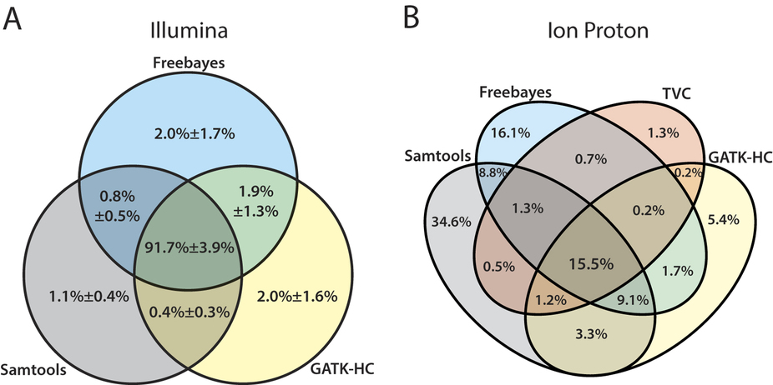
Summarizing Variant Calls from Different Tools
The mean percentage with standard deviation of confidence variant calls with equal to or higher than
the quality score threshold of 20 are represented for (A) Illumina data sets
Huang et al 2015 doi:10.1038/srep17875

Slide 62
Annotate Variants
module spider snpEff
A file of variant calls in vcf format is needed
A reference sequence with gene annotations is needed
snpEff annotates a vcf file
There are > 2,500 pre-built databases available and you can build your own if needed
Annotates MNP (multiple nucleotide polymorphism)
Codon change due to two SNPs: ACA → GGA
5 325795 . AC GG 23.8901 .
AB=0.428571;ABP=3.32051;AC=1;AF=0.5;AN=2;AO=3;CIGAR=2X;DP=7;DPB=7;DPRA=0;EPP=3.73412;
EPPR=3.0103;GTI=0;LEN=2;MEANALT=1;MQM=33;MQMR=48.5;NS=1;NUMALT=1;ODDS=5.49681;PAIRED=0;
PAIREDR=0.5;PAO=0;PQA=0;PQR=0;PRO=0;QA=114;QR=150;RO=4;RPL=3;RPP=9.52472;RPPR=3.0103;
RPR=0;RUN=1;SAF=2;SAP=3.73412;SAR=1;SRF=2;SRP=3.0103;SRR=2;TYPE=mnp;technology.ILLUMINA=1;
ANN=GG|missense_variant|MODERATE|CD36_51230|CD36_51230|transcript|CAX41505.1|
protein_coding|1/1|c.1657_1658delACinsGG|p.Thr553Gly|1657/1851|1657/1851|553/616||
GT:DP:RO:QR:AO:QA:GL 0/1:7:4:150:3:114:-6.7054,0,-11.1847

Slide 63
Consequence of Amino Acid Change
Assess consequence of amino acid change based on sequence conservation across multiple species using the PROVEAN tool
Variants with a score equal to or below -2.5 are considered “deleterious”
module avail PROVEAN
## PROVEAN v1.1 output ##
# Query sequence file: CTRG_00013.fa
# Variation file: CTRG_00013.var
# Protein database: /scratch/datasets/blast/nr
[16:01:13] searching related sequences...
[16:16:36] clustering subject sequences...
# Number of clusters: 30
# Number of supporting sequences used: 245
[16:18:39] computing delta alignment scores...
## PROVEAN scores ##
# VARIATION SCORE
A431S -0.455
E411K -3.051
E226Q -1.564
Verify that enough supporting sequences were found
“deleterious”

Slide 64
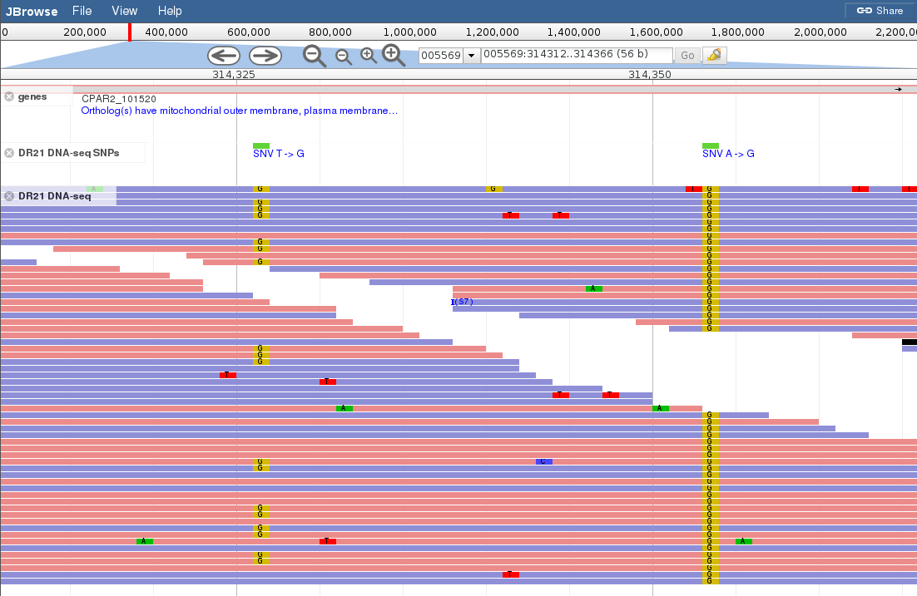
Viewing SNPs in a Diploid Organism
Strand:
Blue = +
Red = -
heterozygous SNP
homozygous SNP

Slide 65
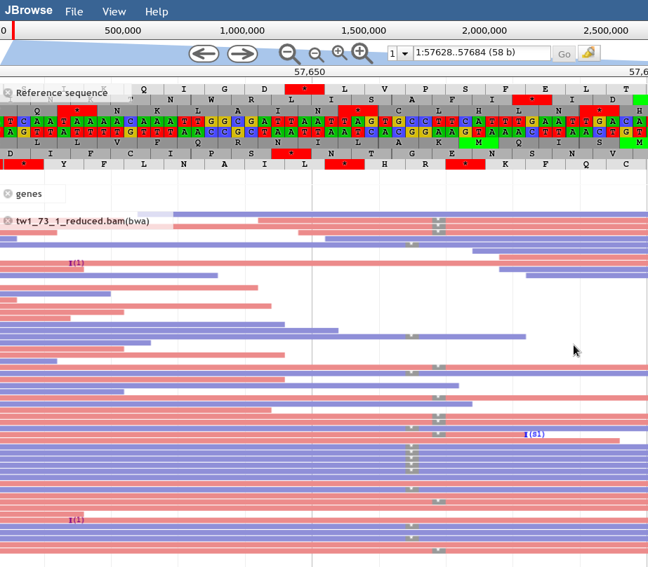
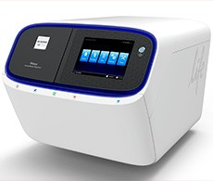
Example of Sequencing Strand Bias
All + strand
All - strand
Strand:
Blue = +
Red = -
Can identify/estimate strand bias using values in vcf file
Strand bias counts:
SRF, SRR, SAF, SAR Bias estimate:
SAP
IonTorrent Proton

Slide 66
Example Job Script
https://github.tamu.edu/cmdickens/GCATemplates/blob/master/templates/ada/run_bwa_0.7.12_freebayes_2015_12_15_snpeff_4.2_pe_ada.sh
BWA
create a bam file of aligning paired end reads to a reference genome
Picard tools
SamSort for sorting alignments on genome coordinates
MarkDuplicates for marking PCR duplicates
Samtools
index bam file
Freebayes
call variants based on bam alignments
snpEff
annotate variants called by freebayes

Slide 67
HPRC Resources
Free Help
Send an email to help@hprc.tamu.edu if you have any questions regarding Bioinformatics tools usage on HPRC clusters
First spend some time investigating the error
read log files, stdout file, stderr file, tool manual
Google search
Google user groups: many are tool specific
Include details about your issue
Which cluster you are using
Which tool you are using
Which modules you have loaded
Commands you used in your job script
Error messages you are seeing
HPRC NGS data analysis tools Documentation
https://hprc.tamu.edu/wiki/index.php/Ada:Bioinformatics

